Slide 1

Course 34366 Intelligent Systems Linear and nonlinear models for classification – September 13, 2022 Darko Zibar dazi@dtu.dk
Introduction to Machine learning
Notes:
https://vas3k.com/blog/machine_learning/?ref=hn

Slide 2
Today’s agenda
Part I – Linear models for classification (~60 min)
Linear and nonlinear regression (repetition)
Multi-layer neural networks
Basic idea behind classification
Decision boundaries
Linear discriminant function
Least squares for classification
Perceptron and neural network
Training of neural networks
Logistic regression
Introduction to problem solving session
Break (~15 min)
Part II – Problem solving session 1 (~120 min)
Part III – Solution to exercises (~40 min)
1

Slide 3
Material
Christopher M. Bishop, Pattern Recognition and Machine Learning, Springer 2006
Introduction (pp. 1-12)
Chapter 4 (pp. 179-186, pp. 192-198, pp. 203-206)
Chapter 5
2

Slide 4
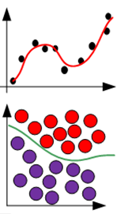
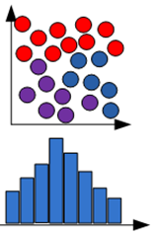

Machine learning
Supervised learning
Regression
Given data x and associated value y, learn y = f(x) or p(y|x)
Predict outcomes
Classification
Clustering
Unsupervised learning
Describe data
Given data x learn useful properties: p(x)
Density estimation
Reinforcement learning
Learning system
Feedback based optimization with interaction reward
reward
action
Improve
Environment
3

Slide 5



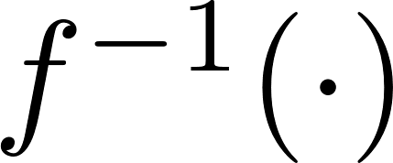


Where does machine learning excel?
Learning complex direct mappings:
Learning complex inverse mappings:
Learning decision rules for complex mappings:
Use neural networks to learn and
4

Slide 6
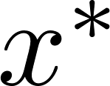
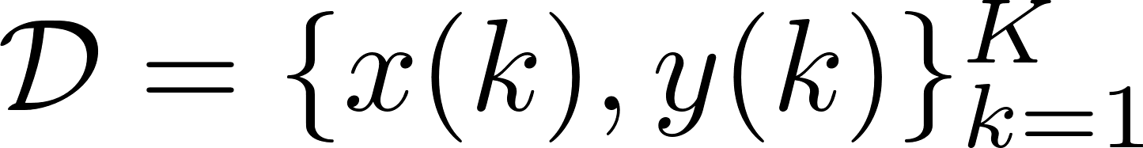

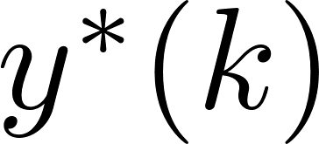
Learning complex functions
1. Given a training data-set (input and output values):
2. For new input
compute
3. Analytical expression unknown, must be learned from:
5

Slide 7
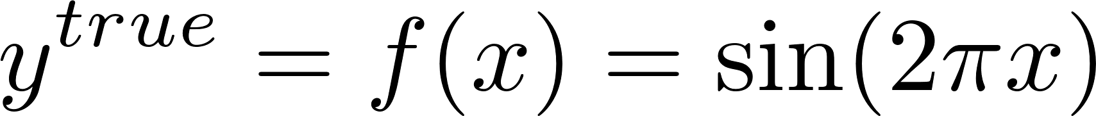
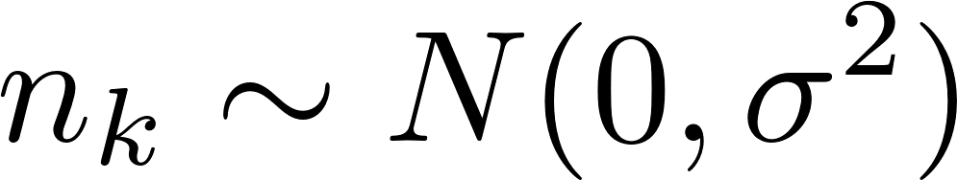
True model and observable data
Assume that a “true” model is given by continuous function:
The measured (observed) data is discrete and corrupted by noise:
Noise assumed to be Gaussian:
6

Slide 8
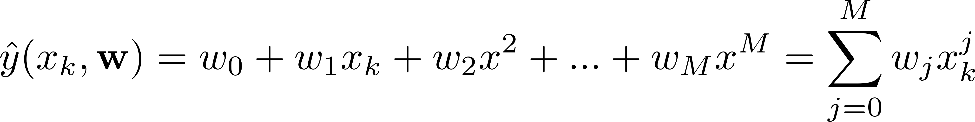
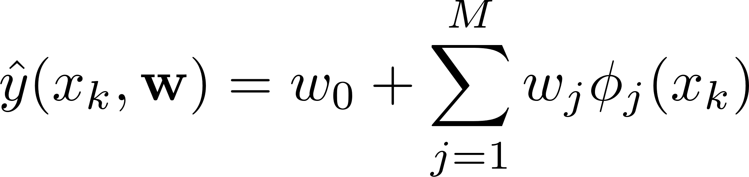

Learning the (linear ) model
Our assumptions (guesses) on the model :
Or
Or
General linear model:
Once we have chosen the model the task is to determine the weights:
Procedure: choose a model then determine the weights
7

Slide 9
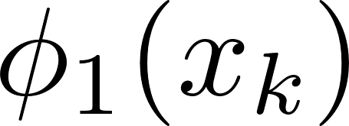

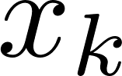
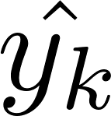
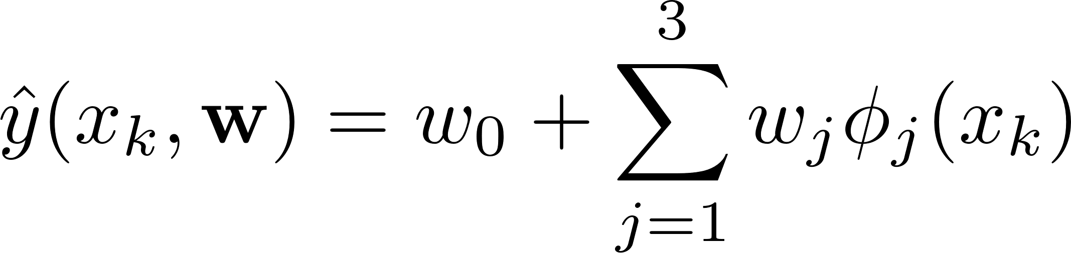
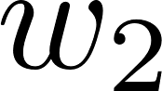
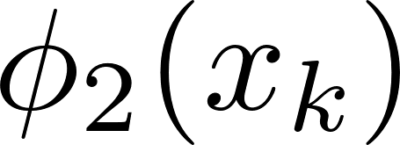
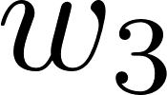
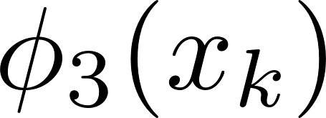

Topology of the linear model
=
1
8

Slide 10
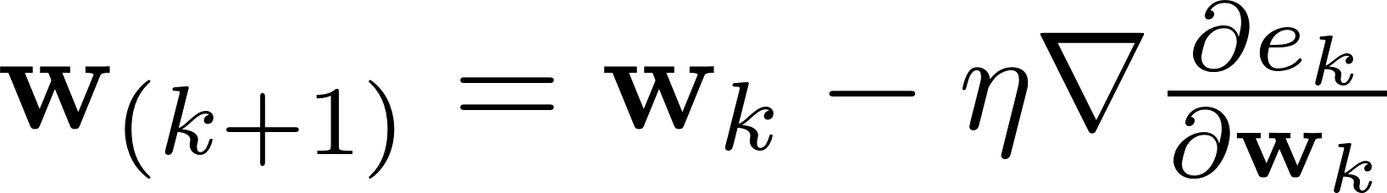
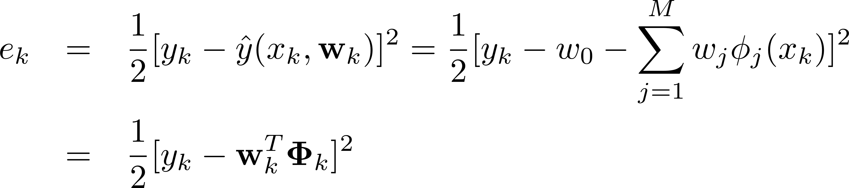
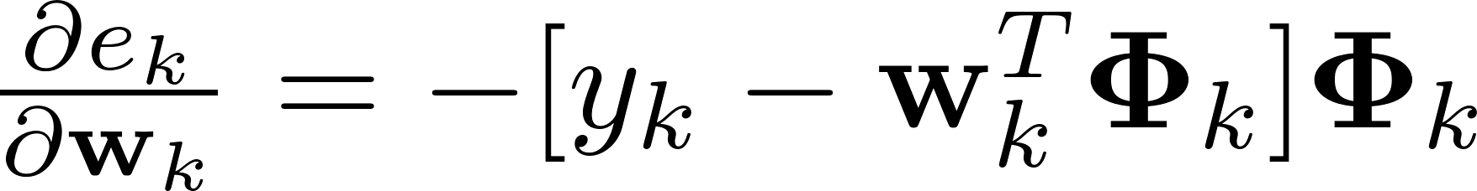

Determining the weights
Gradient descent for weights update:
Defining the mean square error:
Computing the gradient:
for i = 1 : L_iter
for j = 1 : L_train
grad = de(j)dw;
w = w + eta*grad;
end
e(i) = mean(e.^2);
end
1
9

Slide 11
Performance evaluation on training data-set
10

Slide 12
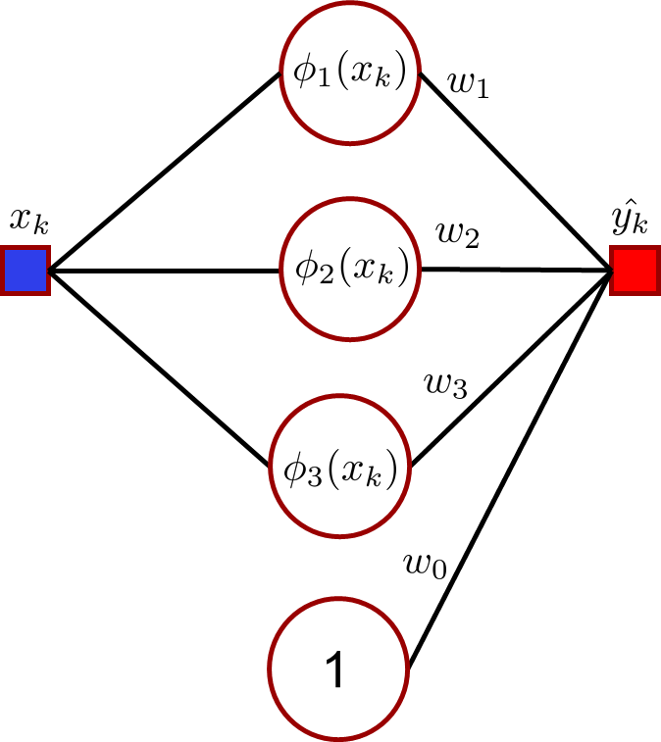
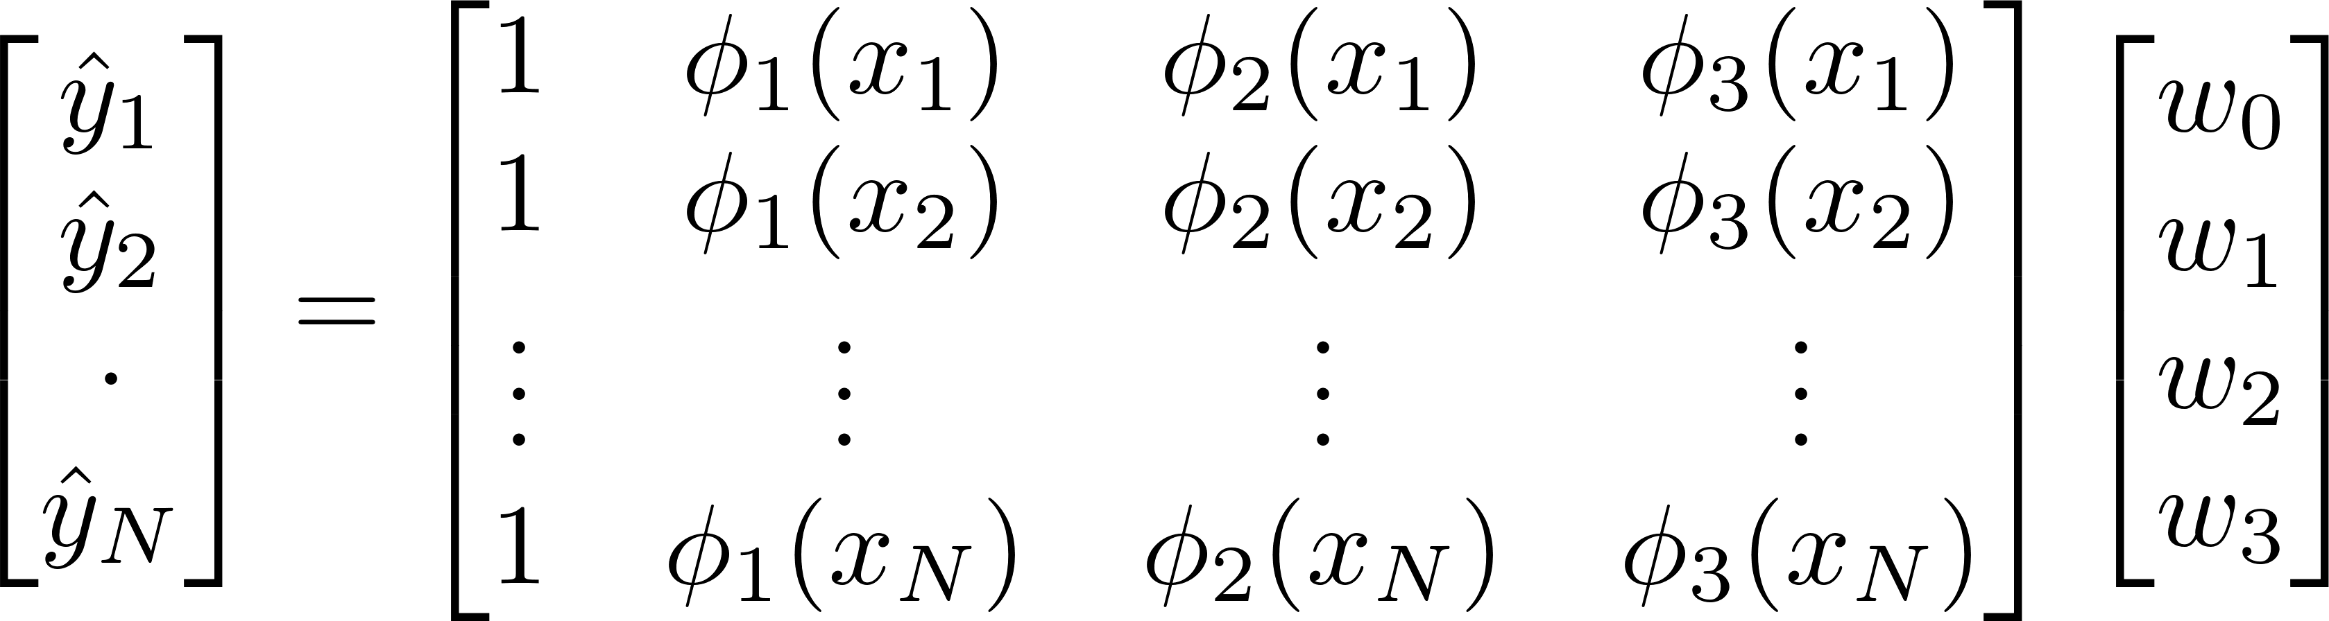

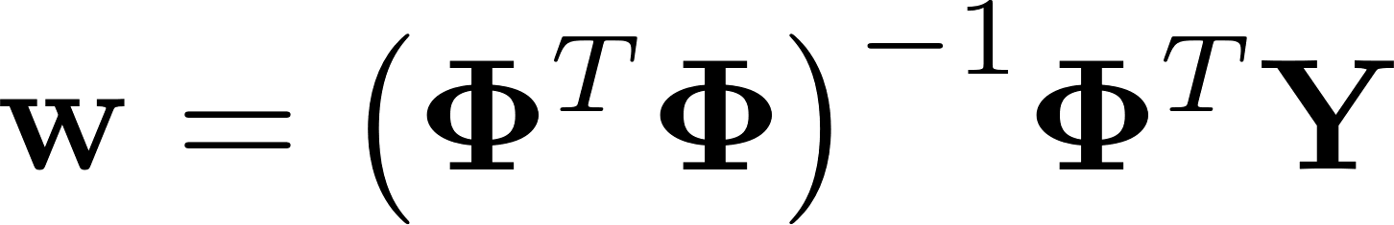

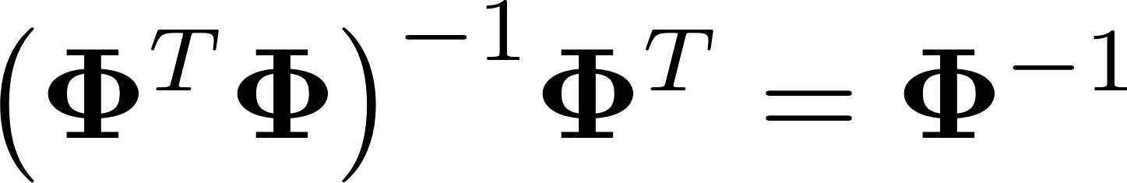
Determining the weights in one step
The output is expressed as:
The weights are computed as Moore-Penrose pseudo inverse:
If is square and invertible:
11

Slide 13
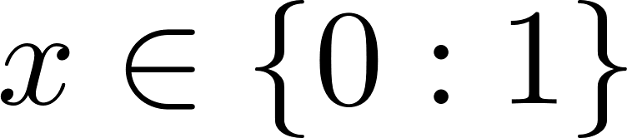
Evaluating the learned the model
Assumed polynomial model order M=2
(too simple model: underfitting)
Assumed polynomial model order M=3
(the right model)
Assumed polynomial model order M=9
(too complex model: overfitting)
Use learned weights to compute:
where
12

Slide 14
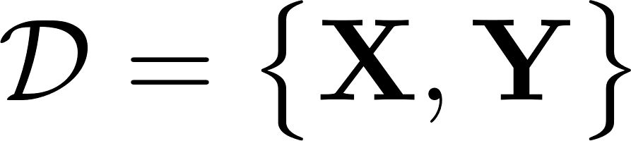
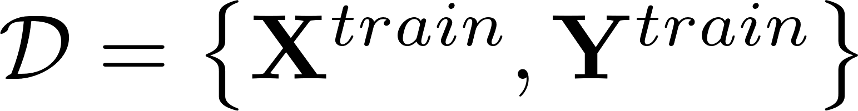
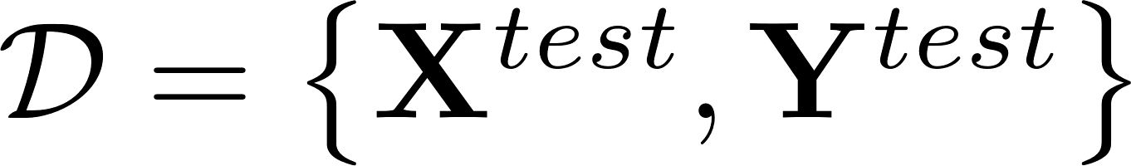

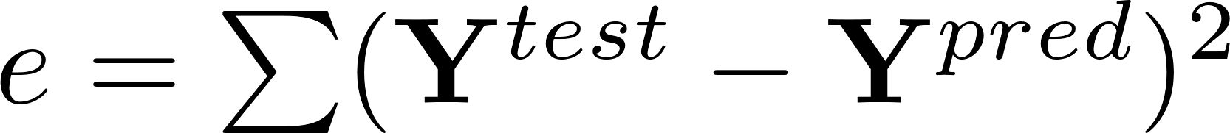
Gather input/output data:
Training data:
Test data:
Split the data
Select the model:
neural network, polynomial, etc
Learn the model parameters:
Evaluate the model:
Evaluate the error:
13

Slide 15
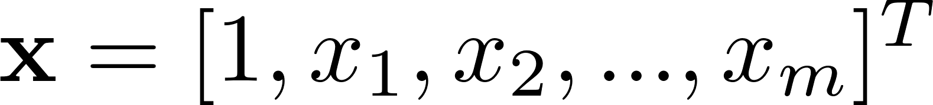
General perceptron
Expressed in mathematical form:
where:
14

Slide 16
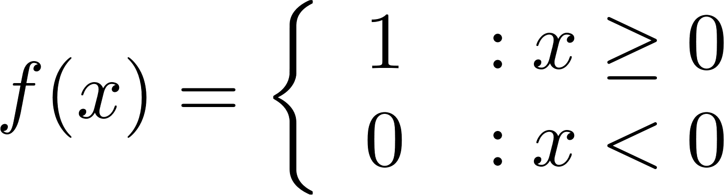
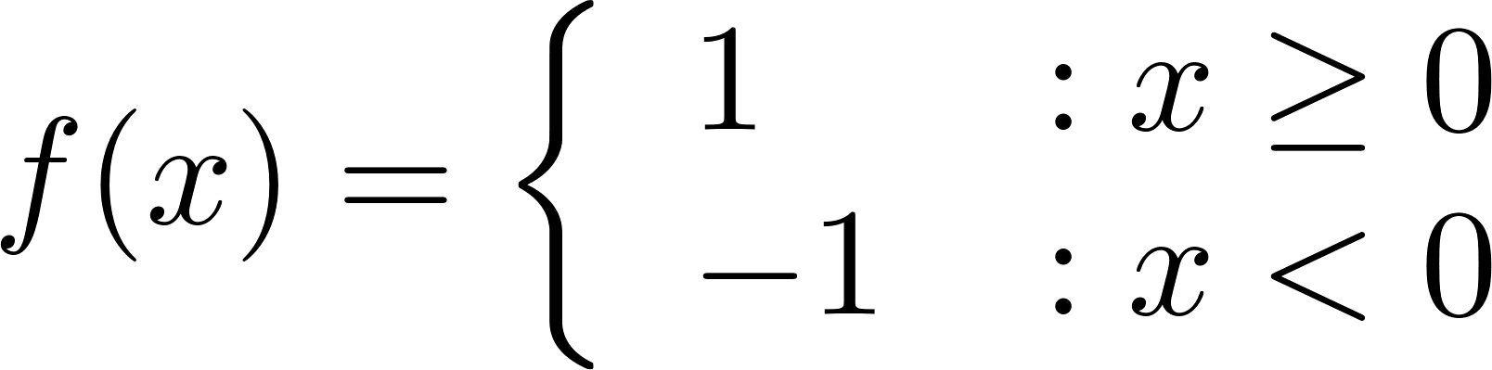
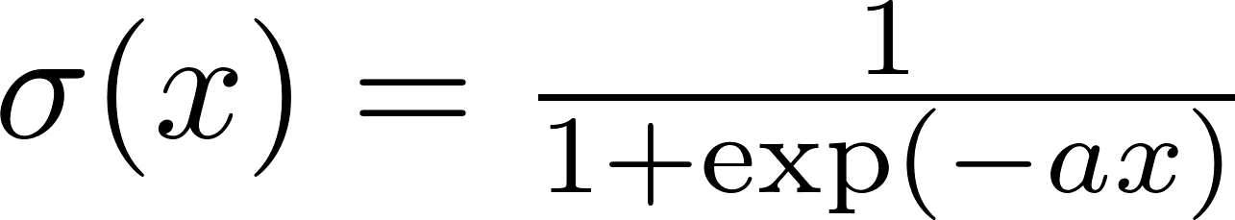
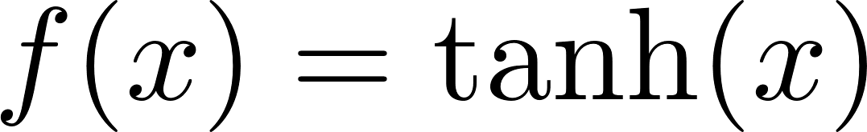
Examples of common basis/activation functions
Threshold function:
Sign function:
Sigmoid function:
Tangents function:
16

Slide 17
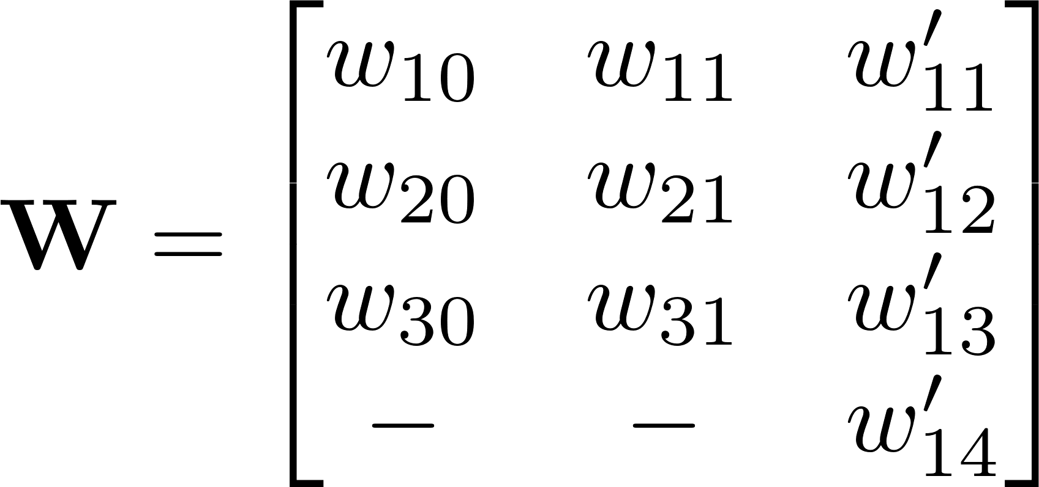
Function learning using NN
Objective: learn the coefficients (central problem in machine learning):
17

Slide 18
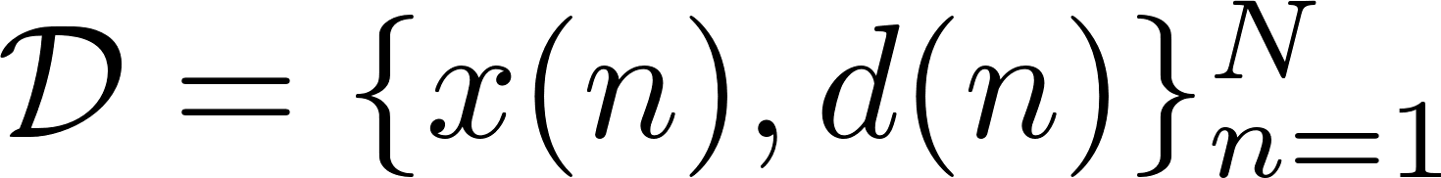
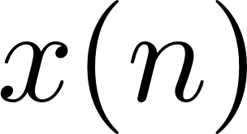
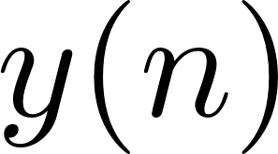
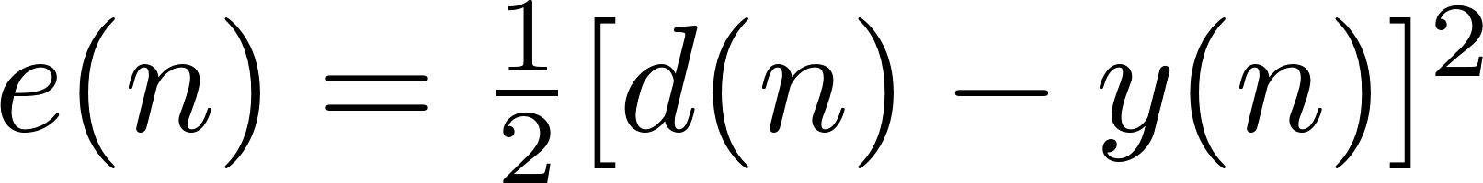
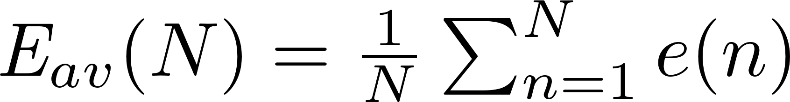
Error definition
1. Given a data set (input and output values):
2. Propagating
through neural network we get
3. The error is defined as:
4. Averaging over the entire data-set:
18

Slide 19
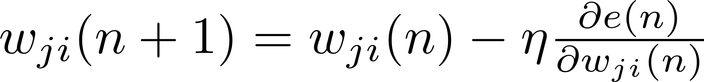
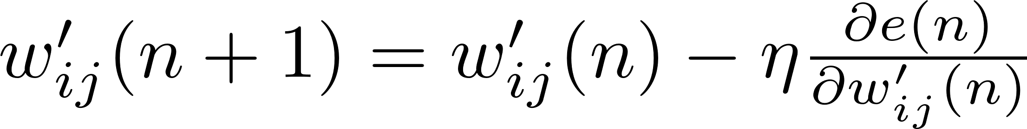
Weight update rule
On-line learning framework:
for k = 1 : N_epochs
%reshuffle data set
for n = 1 : N_samples-1
w'(n+1) = w'(n) - eta*d_e_dw';
w(n+1) = w(n) - eta*d_e_dw;
end
E_epochs(k) = [w(N),w'(N)];
end
19

Slide 20
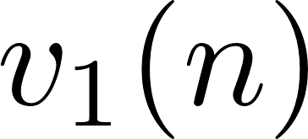
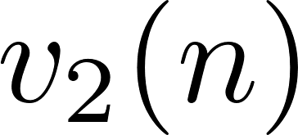
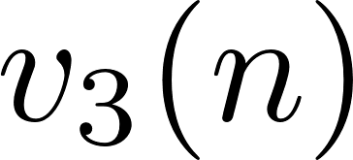
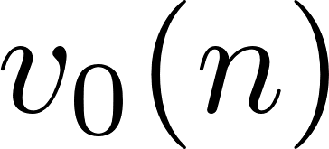
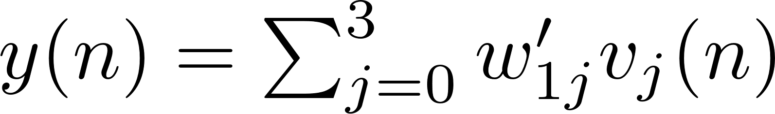
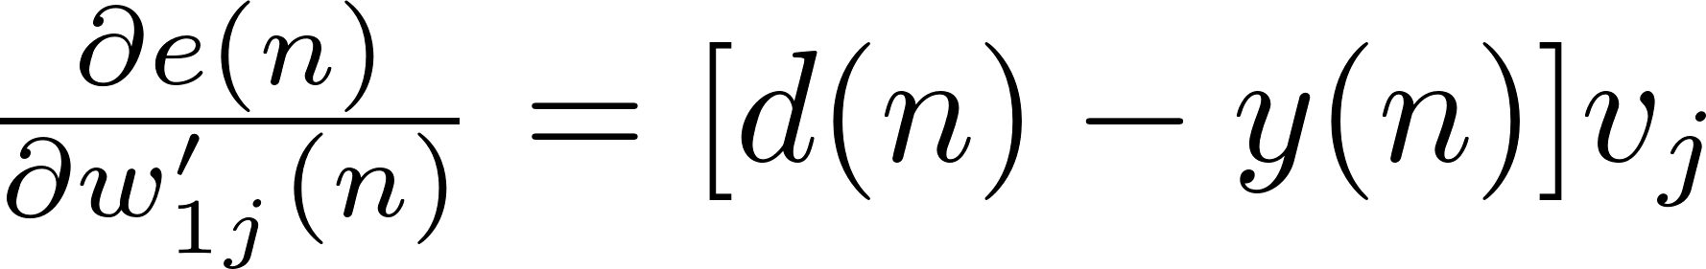
Computing derivatives I
The error defined as:
The output of the network:
The gradient then becomes:
20

Slide 21
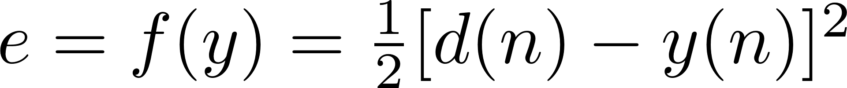




Computing derivatives II
21

Slide 22
Learning parabolic function
%generate training data
L_train = 500;
x_train = -1 + (1+1).*rand(L,1);
y_train = x_train.^2;
%generate test data
L_test = 200;
x_test = -1 + (1+1).*rand(L_test,1);
y_test= x_test.^2;
22

Slide 23






Multi-layer neural network
-How do we determine weight matrices?
-How do we find number of hidden nodes?
-How do we find number of hidden layers?
-How do we find activations functions?
-How do we find the right topology?
Making multi-layer networks work is complex
23

Slide 24


Supervised learning classification
24

Slide 25





Classification problem
?
?
1. Given a training data-set (input and output class):
2. For new input
predict the corresponding class
3. Decision boundary must be learned from:
25

Slide 26
The importance of decision boundary
Decision boundary separates classes
26

Slide 27
Example of nonlinear decision boundaries
Nonlinear decision boundaries separates classes
27

Slide 28






Discriminant function
Linear discriminant function:
Inputs:
Weight vector:
Bias:
?
?
Decision boundary:
Decision rule:
if
assigned to class 1
else
assigned to class 2
The objective is to determine the weights and bias
28

Slide 29



Building the data-set for two classes
1.344
0.344
Class 1
1.344
0.344
01
1.112
0.241
Class 2
modify to
1.112
0.241
10
2.196
7.100
Class 1
2.196
7.100
01
29

Slide 30
Building the data-set for three classes
1.344
0.344
Class 1
1.344
0.344
001
1.112
0.241
Class 2
modify to
1.112
0.241
010
2.196
7.100
Class 1
2.196
7.100
001
0.811
1.344
Class 3
0.811
1.344
100
5.124
2.344
Class 2
5.124
2.344
010
7.196
6.344
Class 3
7.196
6.344
100
30

Slide 31




Least squares for classification I
Each class described by its own linear model:
Grouping it together:
Writing it out:
An input is assigned for the output for which is largest:
The objective is to determine weights matrix
31

Slide 32







Least squares for classification II
Given the training data-set:
1.344
0.344
0
1
1.112
0.241
1
0
2.196
7.100
1
0
Define matrices:
The error between the output of the model and true classes:
32

Slide 33



Least squares for classification III
The sum-of-squares error function:
Error is minimized for:
The weight matrix is then given by:
33

Slide 34







Rossenblatt perceptron (simplest neural network)
An example of a linear discriminant model:
The objective is to determine weights matrix
34

Slide 35






Perceptron algorithm
Input:
where:
1.344
0.344
-1
1.112
0.241
1
Output (true classes):
where:
2.196
7.100
1
Weights:
where:
Algorithm:
for
end
Learning rate coefficient:
35

Slide 36
Results of perceptron algorithm
36

Slide 37






Probabilistic generative models
Probability of belonging to Class 1,
where:
?
?
Probability of belonging to Class 2,
37

Slide 38
Logistic sigmoid
Logistic sigmoid functions maps the whole real axis into a finite interval [0;1]
38

Slide 39




Logistic regression
1.344
0.344
0
1.112
0.241
1
2.196
7.100
1
if
assigned to class 1
else
assigned to class 2
39

Slide 40







Weights learning rule
For a given data-set:
where
and
where
Taking the derivative, the update rule becomes:
40

Slide 41

Transformations using basis functions
Class 2
class 2
class 1
class 2
class 1
Transforming inputs changes nonlinear decision boundary to the linear one
41

Slide 42


Logistic regression with input transformations
if
assigned to class 1
else
assigned to class 2
42

Slide 43








Nonlinear classifier – neural network
Unknown weight matrices that need to be determined:
1.344
0.344
0
1
1.112
0.241
1
0
2.196
7.100
1
0
43

Slide 44
In this lecture we have learned….
Difference between classification and regression
Linear and nonlinear decision boundaries
Discriminant function
Logistic regression
Difference between training and test set
Least squares for learning decision boundaries
Matrix inversion
Iterative method
Neural networks for classification
Transformation of nonlinear to linear decision boundaries
44

Slide 45
Problem solving session
Generate 3 classes by drawing samples from 2-D Gaussian distribution
Split the data-set into training and test
Implement the least squares method for learning weights within discriminant function
Implement perceptron algorithm for two class classification
Implement the least squares method and perform logistic regression
Test you implementation by performing classification on test set
38

